Slide 1

SSP Pure Broking
Azure Guide – for MacOS
September 2024
Important note - if you are running Windows in parallel on your Mac, then please refer to our Azure Virtual Desktop Guide for Windows PC users as opposed to this version.

Slide 2


PURE BROKING – AZURE
INTRODUCTION AND SET-UP – for MacOS users
What is Microsoft Azure?
Microsoft Azure, commonly known as ‘Azure,’ is Microsoft’s public cloud computing platform. It provides world leading cloud computing services to well-known technology brands, such as HP and Fujitsu, as well as being utilized by Microsoft themselves.
The upgrade will change how you log into Pure Broking by doing away with Citrix. It will provide access to a more modern, yet familiar desktop experience with enhanced security, reliability and performance.
This investment is part of our commitment to bring SSP brokers the latest hosting experience enabling SSP to focus more of our R&D investment on our customers’ needs and latest market innovations.
Secure
Scalable
Performant
What’s next … in this guide we will show you how to set-up access to the Virtual Apps and set you on your way to enjoying your new desktop experience …

Slide 3

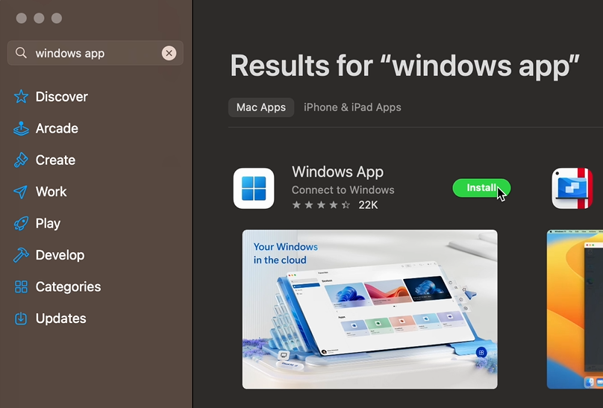
PURE BROKING - AZURE
INSTALL THE WINDOWS APP FROM THE APP STORE
STEP 1
Log into your local device, click the App store icon
STEP 2
Open the App store, once running enter ‘Windows App’ into the search bar at the top of the app and press return on the keyboard or click the search icon
Note – the following screen images are relevant to those users running MacOS on their local device. The screen shots and flow have been created for MacOS 14.5 using dark mode. Users running other versions or light mode may see some minor differences, but the overall flow / steps will be the same.

Slide 4
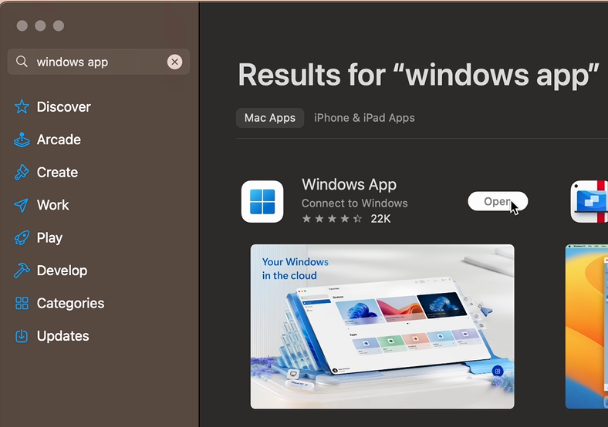
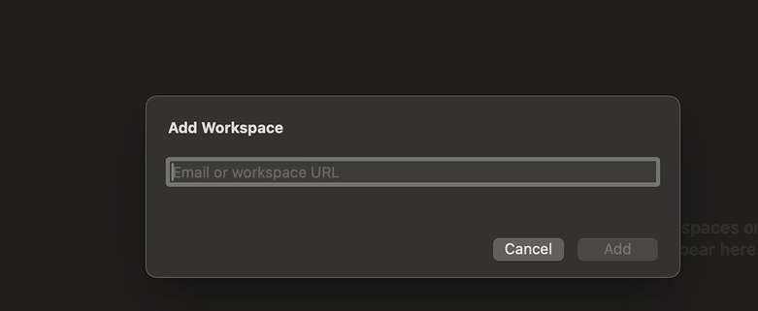
CONFIGURE WINDOWS APP
INSTALL THE WINDOWS APP FROM THE APP STORE
STEP 3
The application will be downloaded, installed and should appear in your applications list. Once completed, double-click the icon to open the app.
STEP 4
Then the ‘Windows App’ application will be launched. Click on the Plus (+) button to add a new workspace. You will need to copy the below URL and paste it into the box and click add.
https://rdweb.wvd.microsoft.com/api/arm/feeddiscovery

Slide 5
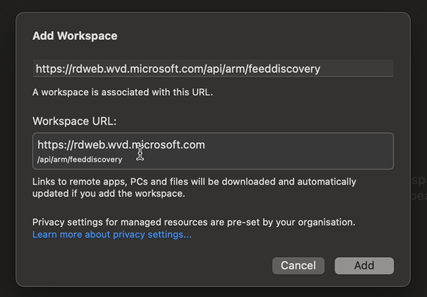
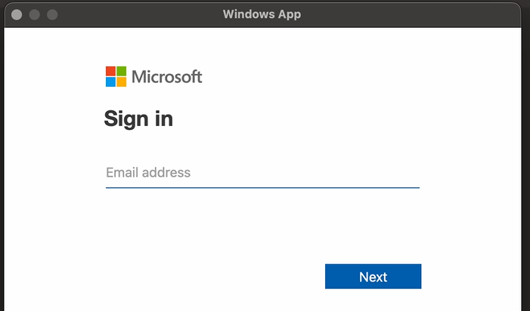
CONFIGURE WINDOWS APP AND LOGIN
INSTALL THE WINDOWS APP FROM THE APP STORE
STEP 5
Check the information display is correct and then click ‘Add’.
STEP 6
After a short pause, you will need to enter your credentials. In the screen that then appears enter your account information (email address) that has been provided to you by SSP and click ‘Next’

Slide 6
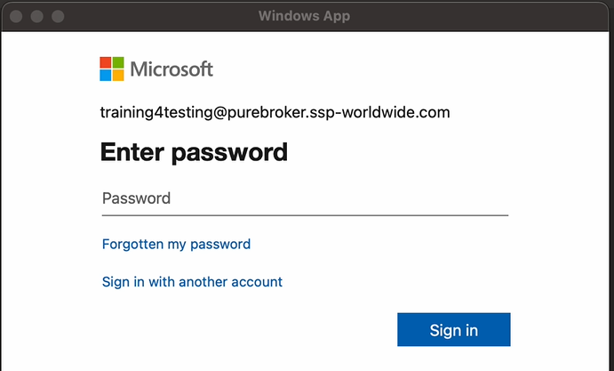
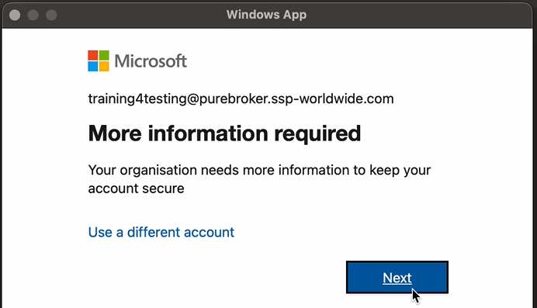
LOGIN AND SET-UP MFA
ENTER YOUR CREDENTIALS
STEP 7
After a short pause, you will need to enter your credentials. In the screen that then appears enter the initial password that has been provided to you by SSP and click ‘Sign in’.
STEP 8
You will be presented with the following pop-up screen. Click Next:

Slide 7
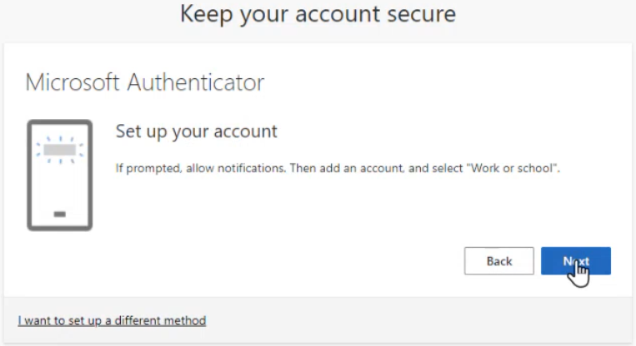
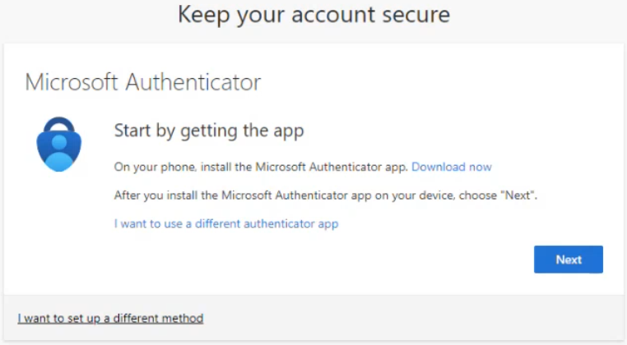
LOGIN AND SET-UP MFA
CHANGE YOUR PASSWORD AND CONFIGURE MFA
STEP 9
Click ‘Next’ and you will start the journey to configure multi-factor authentication. The preferred option is ‘Microsoft Authenticator’ (if you would like to use a different method click on the link at the bottom of the window).
STEP 10 - for mobile app authentication only
Follow the on-screen prompts
If you don’t want to use your mobile phone to authenticate, then please refer to our factsheet for different authentication methods which we can provide upon request.

Slide 8
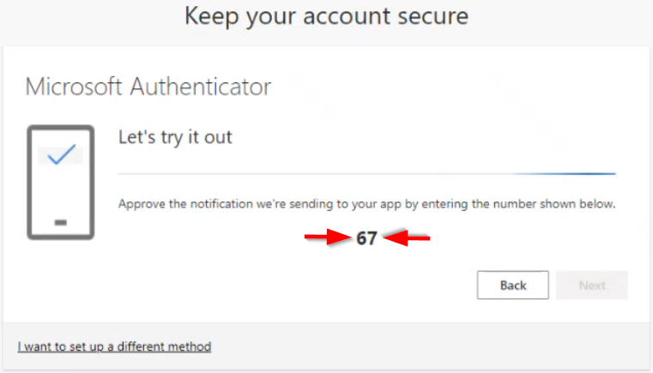
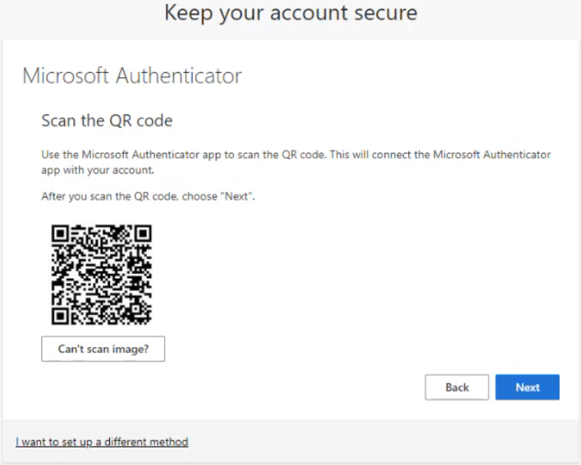
LOGIN AND SET-UP MFA
CHANGE YOUR PASSWORD AND CONFIGURE MFA
STEP 11 – for mobile app authentication only
Use your mobile phone to authenticate, scan the bar code using the App to register. You’ll be prompted to Open the Authenticator app, and then select > Add work or school account > Scan a QR code, then click ‘Next’.
STEP 12
Enter the number displayed on the screen into your Authenticator App, then click ‘Next’.

Slide 9
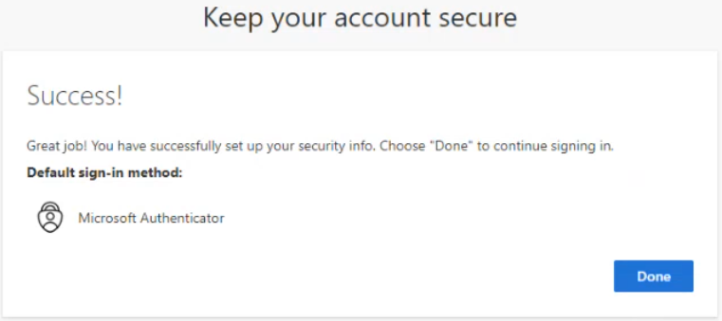
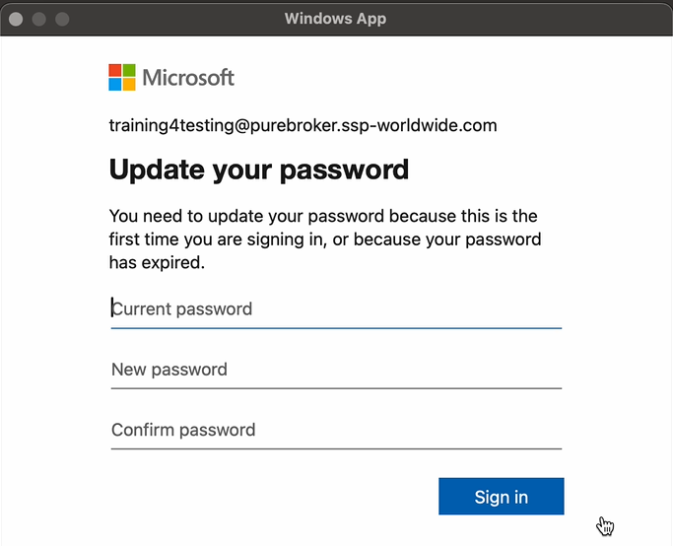
LOGIN AND SET-UP MFA
CHANGE YOUR PASSWORD AND CONFIGURE MFA
STEP 13
A success message will be displayed, click ‘Done’.
STEP 14
You will now be asked to update the generic password because this is the first time you are signing in. Enter the password supplied by SSP (as the current password) and then enter and confirm your new preferred password. Guidelines on secure password formats are provided in Appendix A at the end of this pack.

Slide 10
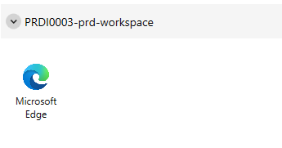
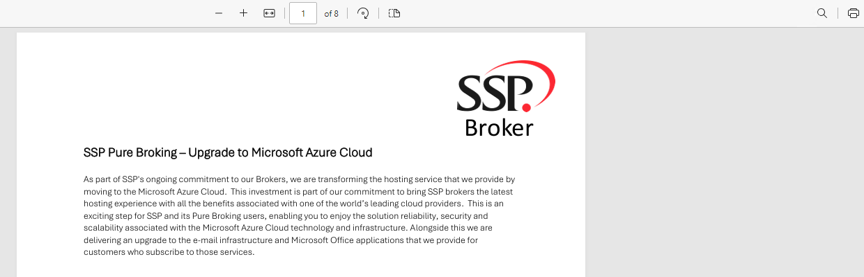
WINDOWS APP
TEST ACCESS AND PRINTING
STEP 15
The ‘Windows App’ will refresh, and you will be presented with a screen like the one shown below.
STEP 16
Double click on the ‘Microsoft Edge’ icon which will open a test FAQ document. Click the Print icon and ensure your printers are displayed, and then print the FAQs – if you encounter a problem email us at migrationteam@ssp-worldwide.com.

Slide 11
WINDOWS APP
COMPLETE PRINTER TESTING AND CLOSE FAQ DOCUMENT
STEP 17
SSP recommend that testing of all your printers is conducted prior to migration. This testing should mirror the printing activities conducted as part of your business processes, e.g., double-sided printing, printing from a specific tray, printing in booklet form, etc.
STEP 18
When you have completed your print testing close the FAQ document.

Slide 12
WINDOWS APP
THANK YOU
Congratulations !
You have completed your first tasks … and tested printing. The Pure Broking application will NOT be visible until you are upgraded, the date for which has been shared with you separately.
Thank you for taking the time to get set for your Azure Cloud migration. If you have any other questions, you can reach us at migrationteam@ssp-worldwide.com

Slide 13
APPENDIX A
PASSWORD GUIDANCE
PASSWORD FORMAT
Allowed characters: A-Z , a-z , 0-9 , space and special symbols @ # $ % ^ & * – _ ! + = [ ] { } | \ : ‘ , . ? / ` ~ ” ( )
Password complexity: at least 3 out of 4 character groups (uppercase, lowercase, numbers, and symbols)
Password length: minimum 14, maximum 256 characters
The user cannot use the 24 previous passwords
A user can only change their password once a day

Slide 14
CONFIDENTIALITY STATEMENT
SSP Limited has prepared this document in good faith. Many factors outside SSP Limited’s current knowledge or control may affect the recipient’s needs and project plans. Errors in the document will be corrected once discovered by SSP Limited. The responsibility lies with the recipient to evaluate the document for applicability. The information in this documentation is proprietary, confidential and an unpublished work and is provided upon recipient’s covenant to keep such information confidential. Personal Data supplied in this document may not be used for any purpose other than for which it was supplied. Personal Data may not be transferred to other parties without prior consent of SSP Limited. In no event may this information be supplied to third parties without SSP Limited’s prior written consent.
The following notice shall be reproduced on any copies permitted to be made.
14

